Slide 1
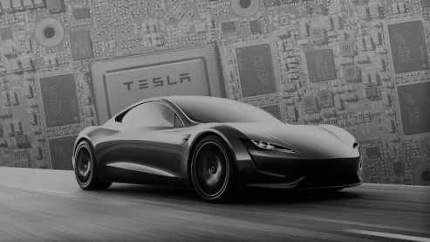
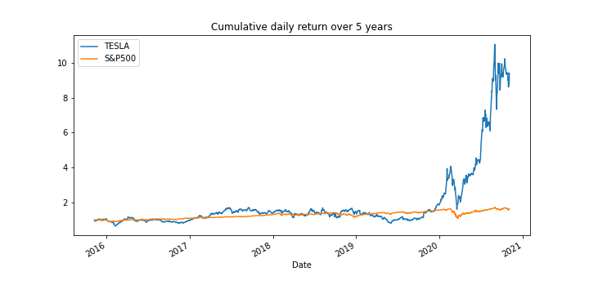

YOUR NEXT INVESTMENT
WHY NOT

Slide 2
Team members:
Minh Tran
Syed Naqvi
Rodrigo Guazzelli
Hsuan Liu
Abdullah Mamun

Slide 3
Growing Industry
Market size, CAGR of EV market (Global and US market),
Yearly sales of EV vs gas vehicle – to show the uptrend of EV sales?
EV sales portion vs New car sales
Diversification Effect:
TSLA revenue breakdown by segment and region
Financial:
TSLA Financials: EBITDA, capex, profitability, risk of the investment
TSLA valuation- comparable model
Stock Price Performance and Simulation:
Historical stock price of TSLA and S&P500 and TSLA’s main competitors from 2015-2020
Monte Carlo simulation for the next 20 years

Slide 4
EV Outbreaks , from 2020 to 2040:
EV cars in road in 2020
Percent of global passengers will use Evs by 2040.
500,000 e-buses
400,000 electric delivery vans and trucks
184 million electric mopeds, scooters and motorcycles on the road globally.
source: Bloomberg
EVs hit global passenger vehicle sales 10% in 2025 .
It will be increased by 28% in 2030.
It will be increased by 58% in 2040.
source: Bloomberg
Green Hydrogen cost cut
Evs performance by 2040.
Green hydrogen costs will fall by up to 64% by 2040.
Source: wood Mackenzie
By 2040, 500 million passenger uses EVs on the road
31% of the world's passenger cars are electric
source: Bloomberg

Slide 5
EV Outbreaks , from 2020 to 2040
Ev charging unit in North America and Europe.
Ev impact on Americans private house hold incomes
In North America and Europe 500,000 charger units in 2022 and its reach over 1.25 million by 2025,
Sources Wood Mackenzie
USA private house hold can save $ 255 to $791 per year
In total, the private benefits for the main Aggressive and Low Cost scenarios range from $18.6 billion to $27.3 billion per year by 2035.
source: NREL

Slide 6
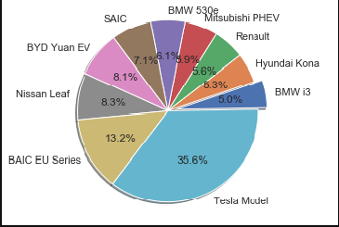
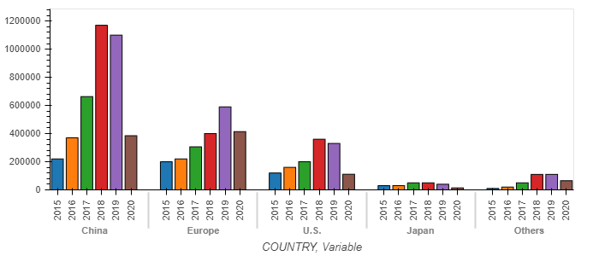
EV MARKET 2015 - 2020
TOP 10 EV Makers 2019
EV sales globally 2015 to 2020(H1)

Slide 7
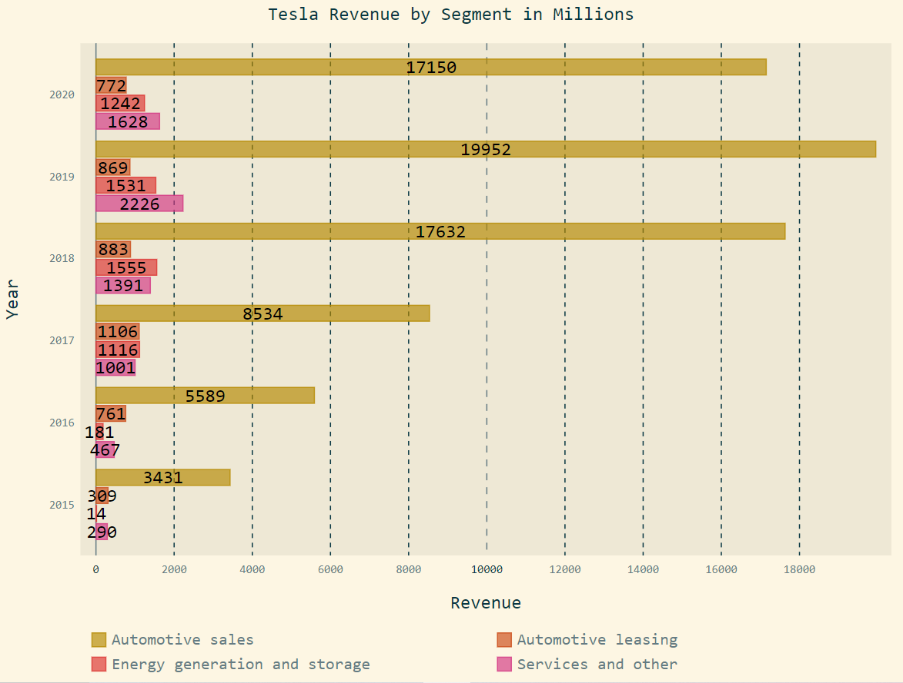
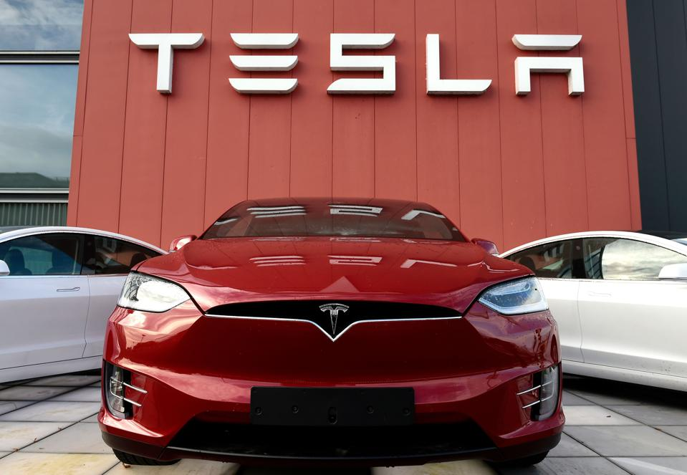
Tesla possible future incomes:
In-house car insurance
Robo-taxi
Ride-hailing Vehicles and Services
FSD & Software as a service
Industry batteries
Computer chips for FSD

Slide 8
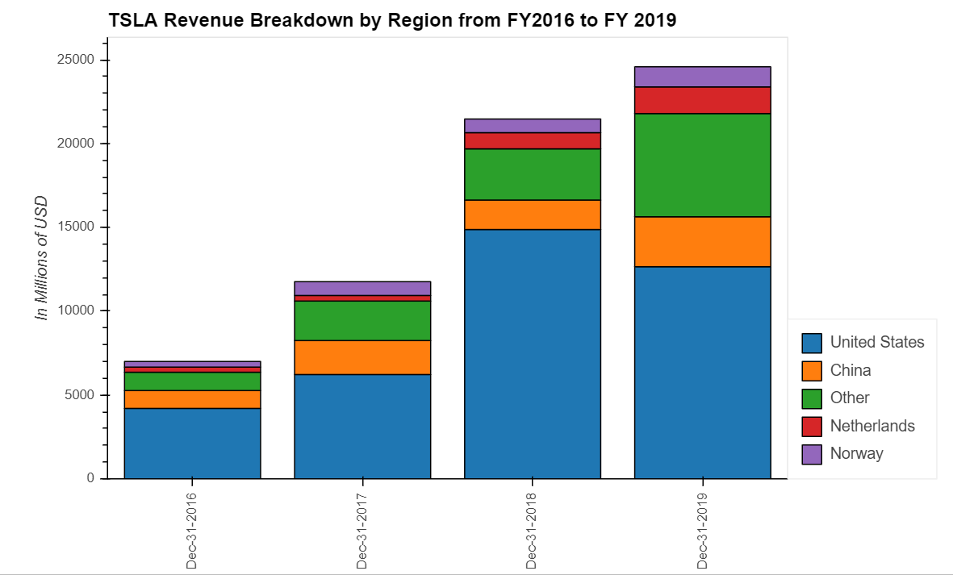
TSLA-Financial Analysis
Revenue breakdown by region
8
Source ：FactSet, Equity Research Report, FS. Note 1, adjusted EBITDA = EBITDA excludes share based payments

Slide 9
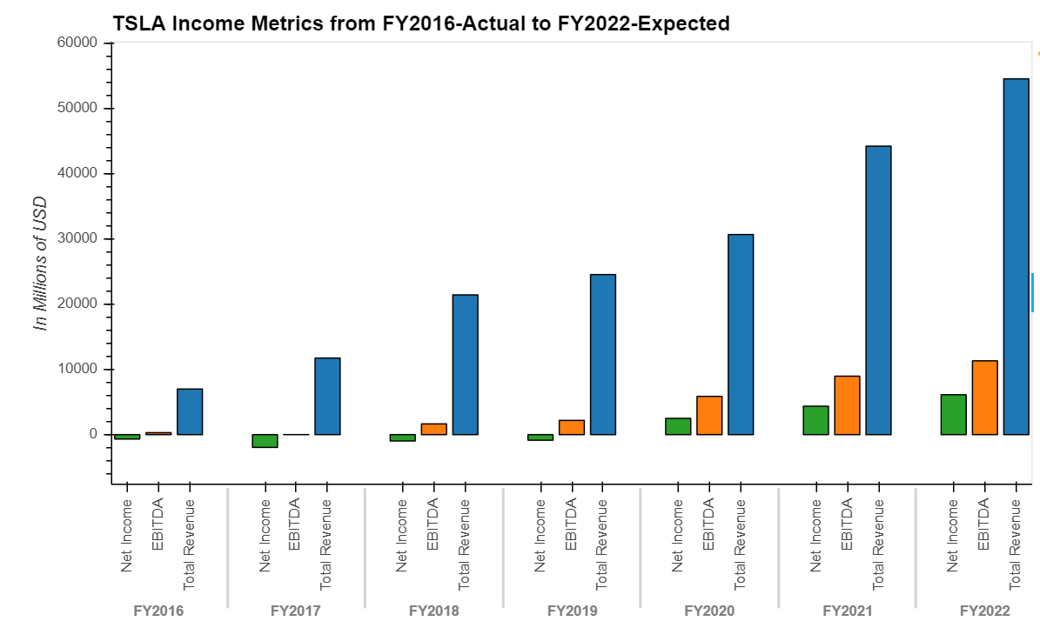
TSLA-Financial Analysis
Income Metrics- Net Income, EBITDA, Revenue
Profitability
Revenue CAGR 36.89% from FY2016 to 2019
EBITDA CAGR 64.12% from FY2016 to 2019
Net Income has turned positive in FY2020
Capex growth trend with cumulative 12 months YoY of 94.62% to $ 2,423 as of Sep 30 2020
Average Capex from FY2016 to 2020 LTM is $2237.4 M
Revenue CAGR 36.89%
EBITDA CAGR 64.12%
9
Source ：FactSet, Equity Research Report, FS. Note 1, adjusted EBITDA = EBITDA excludes share based payments
Notes:
(1,634.9) (1,440.5) (4,081.0) (2,319.0) (1,432.0)

Slide 10
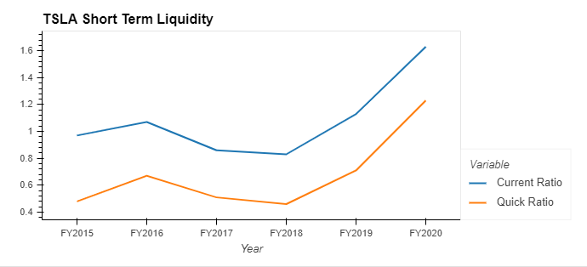
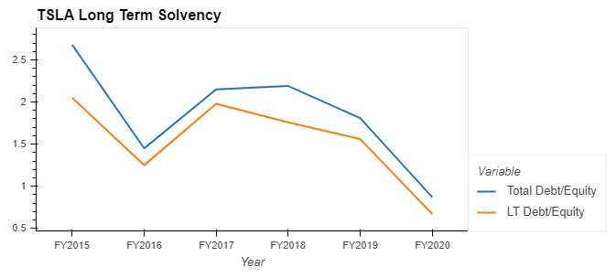
TSLA-Financial Analysis
Short-term Liquidity Analysis
Long-term Solvency
Description to be added
Description to be added
10
Source ：FactSet, Equity Research Report, FS

Slide 11
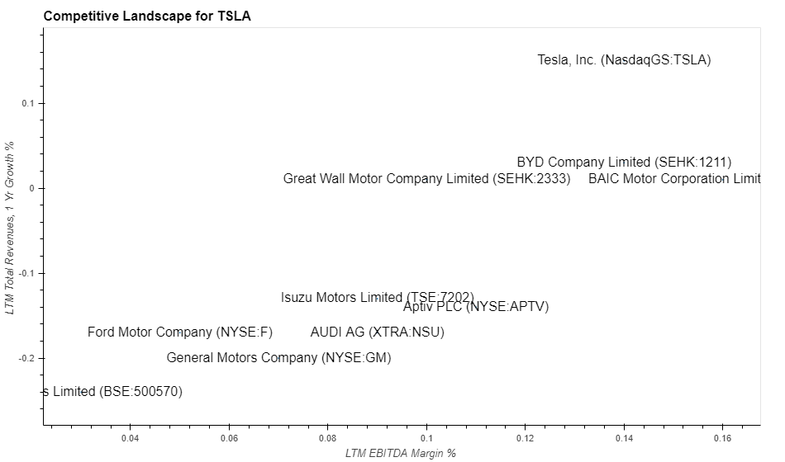
TSLA- Competitive Landscape
First Tier Company - TSLA
Selected EV Competitors
General Motors - GM
Ford Motor Company
BAIC Motor Corporation
Aptiv PLC
BYD Company
Great Wall Motor Company
Isuzu Motors
AUDI AG
TESLA - TSLA
Highlights
TSLA has EBITDA margin around 14% and revenue YoY of 15%, serving as an industry leader
Compared to industry median of 9.5% EBITDA Margin and -13.5% 1-year Revenues Growth, TSLA becomes competitive and first tier candidate
11
Notes:
General Motors Company
Ford Motor Company
BAIC Motor Corporation Limited
Aptiv PLC
BYD Company Limited
Great Wall Motor Company Limited
Isuzu Motors Limited
AUDI AG
Tata Motors Limited
LTM EBITDA Margin % 0.095 LTM Total Revenues, 1 Yr Growth % -0.135

Slide 12
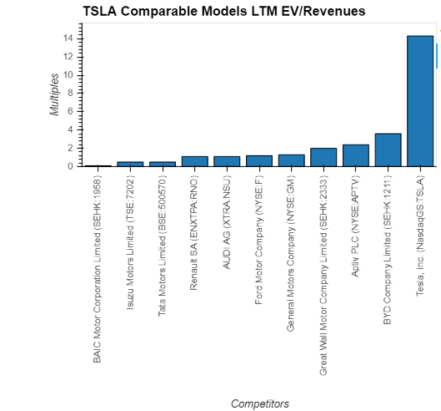
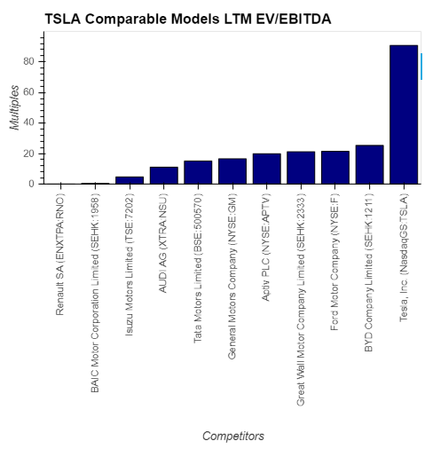
TSLA-Comparable Models
Valuation Highlights - EV/Revenues LTM is 14.3x
Valuation Highlights - EV/EBITDA LTM is 90.8x
Industry Median:1.2x
Industry Median:16.6x
12
Source ：FactSet, Equity Research Report, FS
Notes:
TEV/Total Revenues LTM – Latest 14.3
TEV/EBITDA LTM – Latest 90.8
Industry 50th percentile
TEV/Total Revenues LTM - Latest 1.2 TEV/EBITDA LTM - Latest 16.6

Slide 13
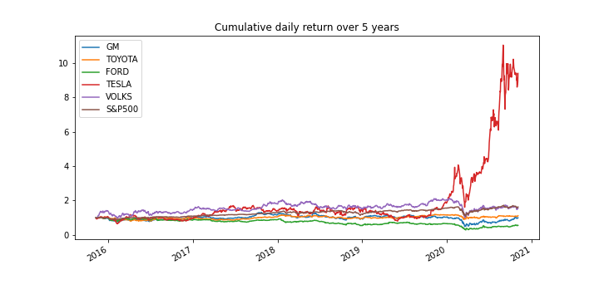
TSLA-Historical price Analysis for the last 5 years
TSLA vs competitors
Source ：Alpaca trade API / Yahoo Finance

Slide 14
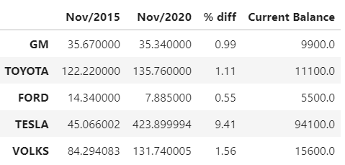
TSLA-Historical price Analysis for the last 5 years
Stock price
If you had invested $10,000 in TESLA stock 5 years ago your current balance would be $94,100
Source ：Alpaca trade API / Yahoo Finance

Slide 15
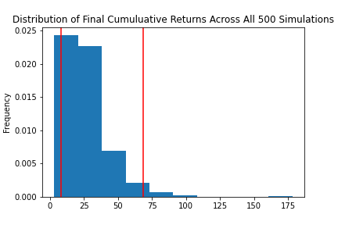
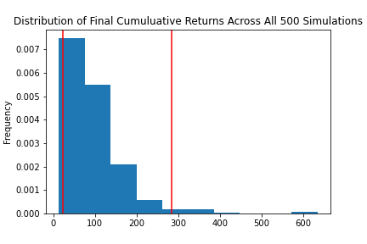
TSLA-Sensitivity Analysis for next 20 years
Monte Carlo Simulation Portfolio Without Tesla
Monte Carlo Simulation Portfolio With Tesla
With an initial investment of $10,000 in your portfolio you have a 95% chance it will be within the range of $82,972.21 and $683,666.61 over the next 20 years
With an initial investment of $10,000 in your portfolio you have a 95% chance it will be within in the range of $226,781.95 and $2,835,449.51 over the next 20 years
Portfolio = Apple Inc. , Alphabet Inc. , Johnson & Johnson , Berkshire Hathaway Inc.
Source ：Alpaca trade API / Yahoo Finance

Slide 16
CONCLUSION

